Slide 1

ELECTRON MUSICAL CHAIRS
Modelling rabi oscillations

Slide 2
Outline
introduction | motivation | Methodology results and analysis | Conclusions and future considerations
Quantum Optics | Statistical Description of a Photon | Problem at Hand | Conclusions
Spontaneous Parametric Down Conversion (SPDC) | Quantum Dot | Challenges | Future Considerations
Rabi Oscillations | Lindblad Master Equation | Results and Analysis | Acknowledgements and References

Slide 3
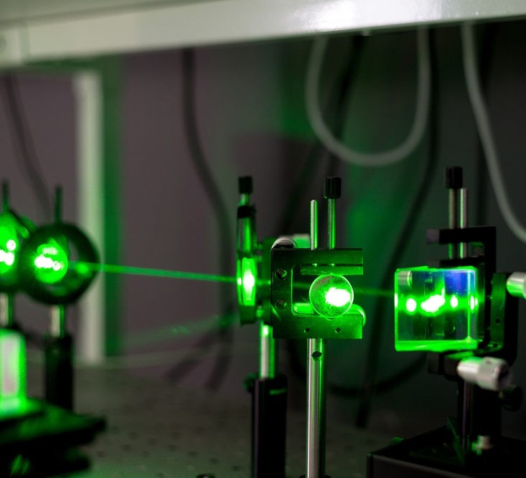
Quantum Optics - 1
Most popular mode of implementation for Quantum Information Processing
Photons are durable and have high mobility
Problematic for the same reasons
Knill, Laflamme, and Milburn Implement (KLM) protocol
https://www.azooptics.com/Article.aspx?ArticleID=1502

Slide 4
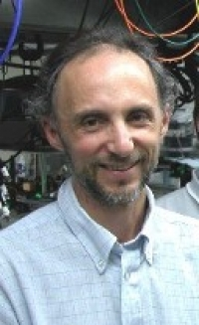


Quantum Optics 2
3 Main Criteria Outlined in Protocol
1. Entangling photon sources
2. High efficiency number-resolving detectors
3. Construction of complex optical circuits that exhibit both quantum and classical interference
Our primary focus will be the first, and without much consideration to the entangling portion

Slide 5
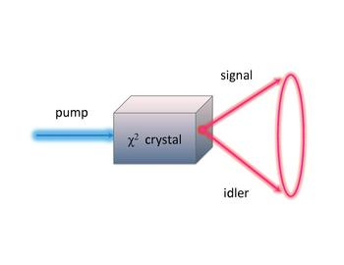
Spontaneous Parametric Down Conversion (SPDC) - 1
Current standard for implementation
Process:
Single photon is incident upon a crystal
Photon is split and outputs entangled photon parirs
Conservation laws are obey
https://en.wikipedia.org/wiki/File:Scheme_of_spontaneous_parametric_down-conversion.pdf

Slide 6

SPDC - 2
However, this is low efficiency process
For every 10⁶ input photons only 4 are output
Those 4 are guaranteed to be entangling
Replace with a new process – The Quantum Dot
https://www.dqglobal.com/blog/efficient-be-ineffective/

Slide 7
Rabi Oscillations - 1
Measure the quantum nature of the object through the presence of Rabi Oscillations
Initial intuition that it was a one and done process
Found to by cyclical instead
Fundamentally quantum in nature due to repopulation of electrons

Slide 8
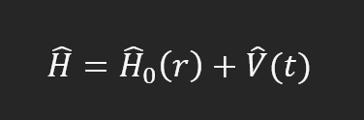
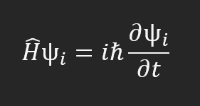
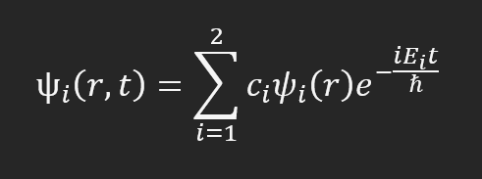
Rabi Oscillations - 2
Hamiltonian of atom excited by an electric field
Solve it using the Schrodinger equation
We find the following wavefunction

Slide 9

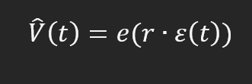

Rabi-Oscillations 3
We can simplify this by considering:
Incident light is resonant with the energy separation between the ground and excited states
Effect of electric field on an atomic dipole
Taking the expectation value to simplify matrix elements

Slide 10
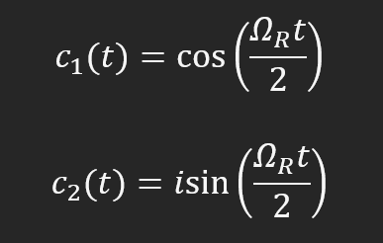
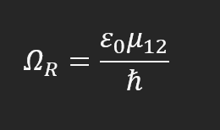

Rabi Oscillations - 4
Solving the differential equation with these simplifications gives us these solutions
Wherein $Ω_{R}$ is the Rabi frequency
Electrons oscillate at frequency $\frac{Ω_{R}}{2π}$

Slide 11
Photon Statistics -1
Now that we know that these oscillations are in fact real and quantum in nature
We need a way to measure this
But we have no way to observe electron dynamics
However, we do have a way to measure their emissions – The Photon
So, in order to paint a picture with photons, we need to understand a description of their nature, the statistical nature

Slide 12
Photon Statistics - 2
Consider another toy model
Beam of light of length L
Divide it into equal N segments
Then take that N out to infinity
What we find is that all the segments do not contain photons, in fact very few of them do

Slide 13
Photon Statistics - 3
We describe this mathematically using binomial theorem
Using some approximations, we end up with the following equation
Called Poissonian Distribution

Slide 14
Photon Statistics - 4
3 Types of Poissonian Distribution characterized by relationship between standard deviation and mean
Focus on sub-Poissonian distribution
Under idealized considerations, there is a photon in every segment of a beam – something akin to deterministic light

Slide 15
Photon Statistics and the Quantum Dot
Theoretically, there is efficiency greater than that of SPDC
4 classes of sub-Poissonian light
Our focus will be the second in which the atom actively takes energy from and external source
In particular, we will focus on the Quantum Dot

Slide 16
The Quantum Dot - Benefits
Quantum Dot has the following benefits
On-demand/deterministic generation of single photons or entangled photons
Low multi-photon emission probabilities
High photon flux
Emit indistinguishable photons
Numerous tuning mechanisms

Slide 17
The Quantum Dot – Structure
Semi-conductor coated by another substance
Reimer group quantum dot is InP-InAsP, a III-V semi-conductor
The other substance must have bandgap that is higher than the optically active quantum dot
Creates a confining potential
If you remember from Quantum Harmonic Oscillator model, this creates a spectrum of bound states

Slide 18
The Quantum Dot – Mechanism - 1
Any solid is characterized with:
A valence band – wherein electrons are bound to the atom
A conduction band – wherein the electrons are excited and free
And a bandgap is an intermediate section that has no electronic states
Upon excitation the electron moves to the excited state and leaves behind an oppositely charged hole
Upon de-excitation the electron recombines with the hole to emit a photon – Radiative Recombination

Slide 19
The Quantum Dot – Mechanism - 2
Quantum dot also produces entangled pairs
Through the presence of a secondary excited state – the biexciton
Not the focus of this project but you will see that this adds some challenge to the problem
Biexciton – Exciton Cascade
Biexciton is a collection of two electron-hole pairs with opposing angular momentum
These undergo two separate recombinations

Slide 20
Biexciton – Exciton Cascade
First recombination generates a left circularly polarized photon and left with an electron-hole pair
Second recombination generates a right circularly polarized photon with the remaining pair
The opposite can happen as well – We don’t know which
Left with following maximally entangled state

Slide 21
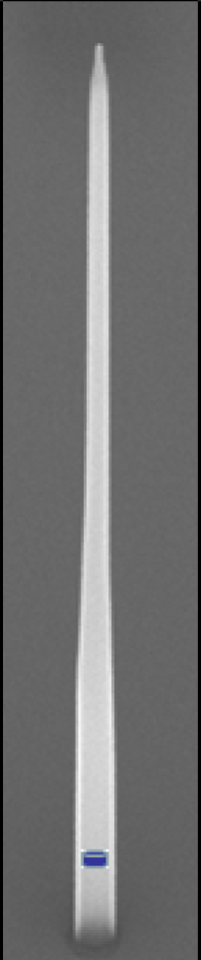
The Quantum Dot – Reimer Group
Excited using two photon resonant excitation
Using a single photon would violate Pauli exclusion principle
Use two photons with opposite angular momenta and half of the biexciton energy
Bombardment with laser makes the likelihood of this occurring high
900 Ti:Sapphire laser with wavelength of 894.0 nm
Post-Excitation Radiative Recombination results in:
Biexciton emission at 894.6 nm
Exciton emission at 893.3 nm

Slide 22
Lindblad Master Equation - 1
Multiple formalisms to describe a system
Hamiltonian results from a Legendre transform of the Lagrangian formalism
Results in total energy of the system
This formalism only considers the system, how do we include environment?
Enter the Lindblad Master Equation
Considers System, Environment, and the Coupling mechanism between the two

Slide 23
Lindblad Master Equation - 2
We can map out our quantum dot system as follows:
Each space is unique and separate from one another
The total system would be the tensor product of the system, environment, and the coupling mechanism
However, for simplicity we can write the environment and the coupling using the basis of the quantum dot

Slide 24
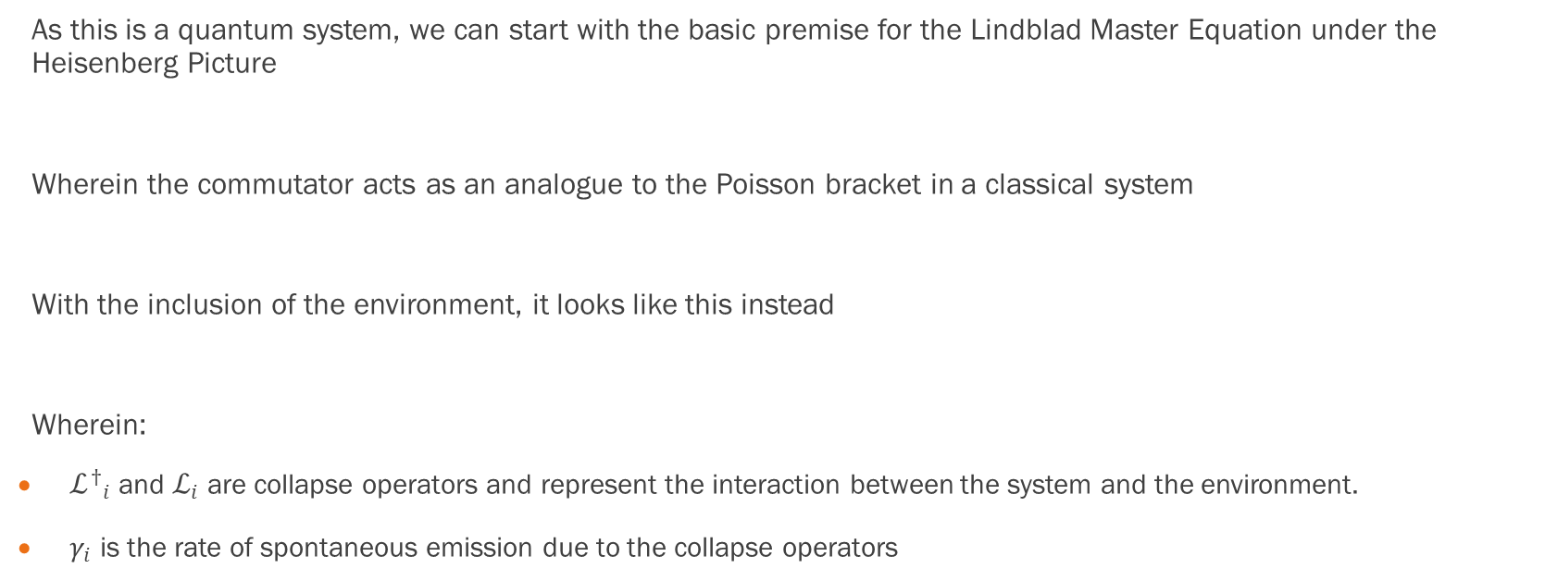
Lindblad Master Equation - 3
As this is a quantum system, we can start with the basic premise for the Lindblad Master Equation under the Heisenberg Picture
Wherein the commutator acts as an analogue to the Poisson bracket in a classical system
With the inclusion of the environment, it looks like this instead
Wherein:
${ℒ^{†}}_{i}$ and $ℒ_{i}$ are collapse operators and represent the interaction between the system and the environment.
$γ_{i}$ is the rate of spontaneous emission due to the collapse operators

Slide 25
Problem at Hand - 1
Ph. D candidate Matteo Pennacchietti performed an experiment to detect Rabi oscillations
Used model provided in Mark Fox to fit his data
Tasked me to find a better model that includes environmental dephasing

Slide 26
Problem at Hand - 2
Coherence and Degree of Time-Bin Entanglement from Quantum Dots
Written by Tobias Huber, Laurin Ostermann, Maximilian Prilmüller, Glenn S. Solomon, Helmut Ritsch, Gregor Weihs, and Ana Predojević
As title suggests this is time bin entanglement rather than polarization, however the Hamiltonian still applies as it is not specific to entanglement mode

Slide 27
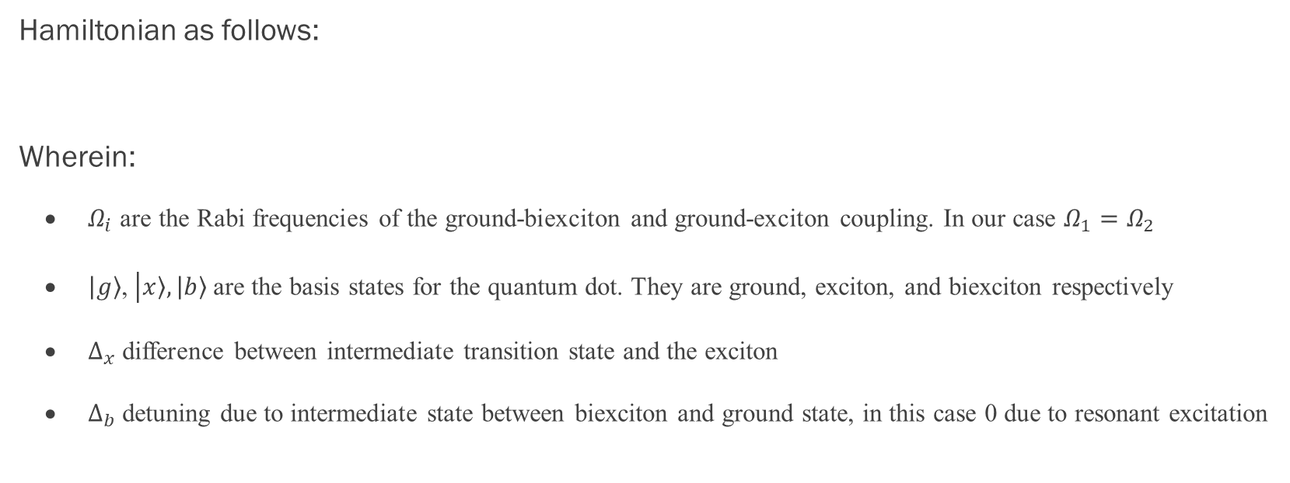
Problem at Hand - 3
Hamiltonian as follows:
Wherein:
$Ω_{i}$ are the Rabi frequencies of the ground-biexciton and ground-exciton coupling. In our case $Ω_{1}=Ω_{2}$
$\left|\left.g\right\rangle \right.$, $\left|\left.x\right\rangle ,\left|\left.b\right\rangle \right.\right.$ are the basis states for the quantum dot. They are ground, exciton, and biexciton respectively
$∆_{x}$ difference between intermediate transition state and the exciton
$∆_{b}$ detuning due to intermediate state between biexciton and ground state, in this case 0 due to resonant excitation

Slide 28
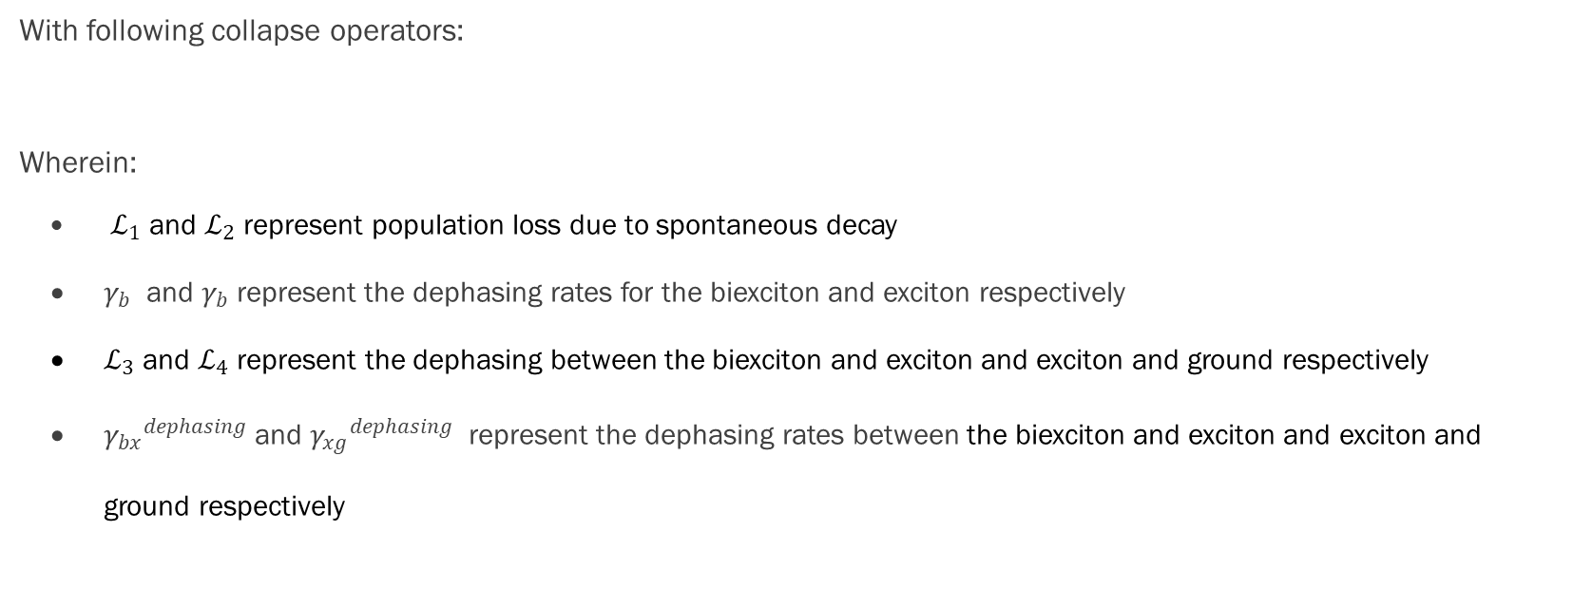
Problem at Hand - 4
With following collapse operators:
Wherein:
$ℒ_{1}$ and $ℒ_{2}$ represent population loss due to spontaneous decay
$γ_{b}$ and $γ_{b}$ represent the dephasing rates for the biexciton and exciton respectively
$ℒ_{3}$ and $ℒ_{4}$ represent the dephasing between the biexciton and exciton and exciton and ground respectively
${γ_{bx}}^{dephasing}$ and ${γ_{xg}}^{dephasing}$ represent the dephasing rates between the biexciton and exciton and exciton and ground respectively

Slide 29
Implementation - 1
With this implementation we can use the Linblad Master Equation
Used QuTiP python package
Solved for the following expectation value:

Slide 30
Implementation - 2
Made implementation easy as it solved the analytical component with the following required parameters:
The Effective Hamiltonian
Wave function: Providing information on the initial state of the system
Gaussian pulse used to excite the system
T-list: A list of times that are used to perform calculations
A Set of Collapse Operators: Which detail dephasing within the system
and a Set of Environmental Operators: Which detail dephasing due to environmental factors

Slide 31
Challenges
Ran into 3 Challenges
Our problem had 3 states (ground, exciton, and biexciton) rather than the usual 2
Rewriting operators so that it made sense to QuTiP
Incident Pulse Shape Interfering with Rabi Oscillation Detection

Slide 32

Challenge 1
Can we construct SU(2) in terms of 3$×$3 matrices?
In simpler terms can we construct 3-D Pauli matrices?
Consider how raising and lowering operators act on 3-D eigenstates

Slide 33
Challenge 1 - Continued
Construct raising and lowering operators based on the above actions
We get the following representation of the raising and lowering operators

Slide 34
Challenge 2
Operators in the Hamiltonian and Liouvillian were not recognizable in QuTiP
Considered material from Dr. Bajcsy wherein he suggests the following transformation:
We can rewrite what we have using 3-D basis in challenge 1, leaving us with:

Slide 35
Challenge 3
Gaussian pulse shape from Kevin Fischer’s two-photon interference tutorial used
Resulted in a typical decay plot
Wanted to remain in short pulse regime used by Reimer group
Standard deviation of the pulse was smaller than the peak intensity of the pulse

Slide 36
Challenge 3 - Continued
No theory for this, so used trial and error method
Found that if standard deviation of the pulse was the same order of magnitude as that of the standard deviation
Rabi oscillations were detected!

Slide 37
Results and Analysis - 1
Parameters input to QuTiP:
The Effective Hamiltonian:
Gaussian pulse used to excite the system:
Wave function:

Slide 38
Results and Analysis - 2
Ground State Population
Starts with 100% probability for occupation
As peaks diminish, oscillates at about 33.33% probability for occupation

Slide 39
Results and Analysis - 3
Exicton State Population
Starts with 0% probability for occupation
Low peak at 45% occupation probability – representative of not wanting direct exciton excitation
However real life may cause direct exciton population
As peaks diminish, oscillates at about 33.33% probability for occupation

Slide 40
Results and Analysis - 4
Biexicton State Population
Starts with 0% probability for occupation
High peak at 90% occupation probability – representative of wanting direct biexciton population
As peaks diminish, oscillates at about 33.33% probability for occupation

Slide 41
Conclusions - 1
Determine quantum nature of the quantum dot by considering Rabi oscillations:
Rabi oscillations are indeed a quantum effect due to electron repopulation
Cannot directly study electrons – study photons instead
Statistical nature of photons lends to the possibility of deterministic source – sub-Poissonian
Quantum dot is a sub-Poissonian source
Biexciton-Exciton cascade requires a 3-state model
Framework to represent all of this and environmental effects – Lindblad Master Equation

Slide 42
Conclusions - 2
5. Python package to put all of this information together – QuTiP
6. Challenges in implementation
3-D system instead of 2-D
Converting operators to a language that python understood
Changing Gaussian pulse to detect Rabi oscillations
RABI OSCILLATIONS IN ALL 3 STATES OF THE QUANTUM DOT!

Slide 43
Future Considerations
However, this is not the end of the story:
QuTiP uses natural units and as such I was not able to implement the Reimer group parameters into this model
Without implementing these parameters, it was difficult to compare it with what Matteo got to see if was better

Slide 44
Acknowledgements
Dr. Michael Reimer for your guidance and supervision
I can comfortably say that I now know how to read research papers and implement a problem-solving scheme to solve problems
QPDL Group
You let me participate in group meetings despite not being very knowledgeable
Matteo Pennacchietti and Sonell Malik
For the guidance and support when I felt like I was stuck on tasks
Husband, Friends, Family, and everyone in the Background
I would not be anywhere without all of you

Slide 45
References - 1
Ahmadi, A. (2019). Towards On-demand Generation of Entangled Photons with Quantum Dots. Waterloo.
Bajcsy, M. (2022, October 6). ECE 770. Lecture #9. Waterloo, Ontario, Canada.
Davidovich, L. (1996). Sub-Poissonian Processes in Quantum Optics. Reviews of Modern Physics, 127-173.
Feranchuk, I., & Leonov, A. (2008). Analytical analysis of the “collapse-revival” effect in the Jaynes–Cummings model. Physics Letters A, 517-520.
Fischer, K. A. (2016). Dynamical Modeling of Pulse Two-Photon Interference. New Journal of Physics.

Slide 46
References - 2
Fischer, K. A., Hanschke, L., Kremser, M., Finley, J. J., Muller, K., & Vucokvic, J. (2017). Pulsed Rabi oscillations in quantum two-level systems:. Quantum Science and Technology.
Fox, M. (2006). Quantum Optics. Oxford University Press.
Huber, T., Osterman, L., Prilmüller, M., Solomon, G. S., Ritsch, H., Weihs, G., & Predojević, A. (2016). Coherence and degree of time-bin entanglement from quantum dots. Physical Review B.
Leica. (2017, November 15). The Fundamentals and History of Fluorescence and Quantum Dots. Retrieved from Leica-Microsystems: https://www.leica-microsystems.com/science-lab/the-fundamentals-and-history-of-fluorescence-and-quantum-dots/#:~:text=Quantum%20Dots%20(or%20%22Qdots%22,Petersburg

Slide 47
References - 3
Manzano, D. (2020). A Short Introduction to the Lindblad Master Equation. Granada.
Matthias, B., Lenhard, A., Chunniall, C., & Becher, C. (2016). Highly efficient heralded single-photon source for telecom wavelengths based on a PPLN waveguide. Optics Express, 23992-24001.
Nexdot. (n.d.). Quantum Dots History. Retrieved December 2022, from nexdot: https://nexdot.fr/en/history-of-quantum-dots/
Papoyan, A., & Shmavonyan, S. (2021). Signature of optical Rabi oscillations in transmission signal of atomic vapor under continuous-wave laser excitation. Optics Communications.
PR Newswire. (2019, February 23). Benzinga. Retrieved from The History and Future of Quantum Dots: https://www.benzinga.com/pressreleases/19/02/r13231898/the-history-and-future-of-quantum-dots

Slide 48
References - 4
reductionista. (2016, October 20). Spin Representation in 3D. Retrieved from Physics Stackexchange: https://physics.stackexchange.com/questions/287542/spin-representation-in-3d
Sigma Aldrich. (n.d.). Quantum Dots. Retrieved from Millipore Sigma: https://www.sigmaaldrich.com/CA/en/technical-documents/technical-article/materials-science-and-engineering/biosensors-and-imaging/quantum-dots
Stievater, T., Li, X., & Steel, D. (2001). Rabi Oscillations of Excitons in Single Quantum Dots. Physical Review Letters.

Slide 49

Thank You
And thank you all for taking the time to listen

